Slide 1

By Sara Iriarte

Slide 2

Data from:
→ Home Feed
→ Trending
Geographies:
ES
FR
IT
US
CA
NO
Identifiable patterns in viewership?
Differences regarding categories?
Correlation between video duration and popularity?

Slide 3

Identifiable patterns in viewership, relationship between video duration and popularity?

Slide 4
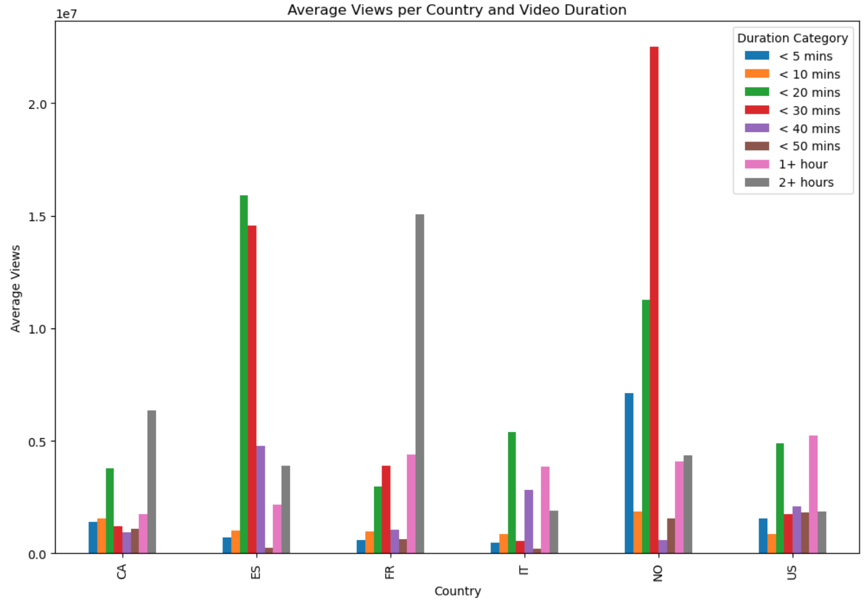
Average Views per Country and Video Duration

Slide 5
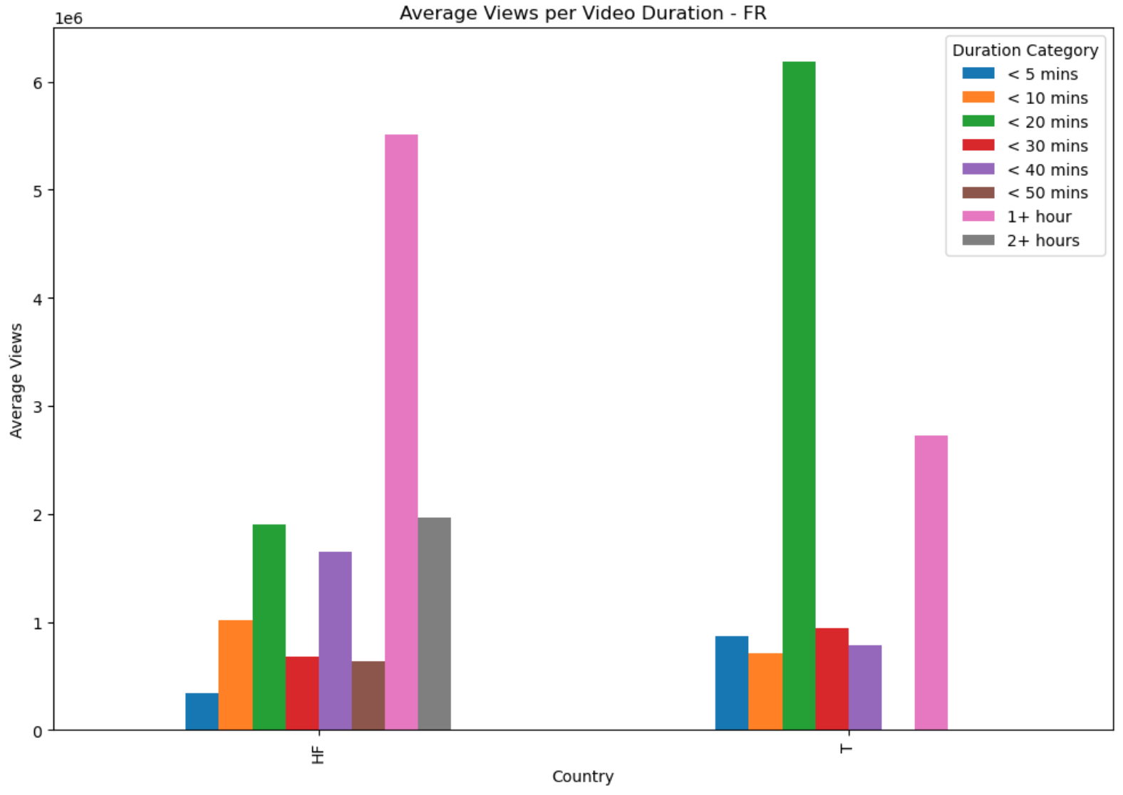
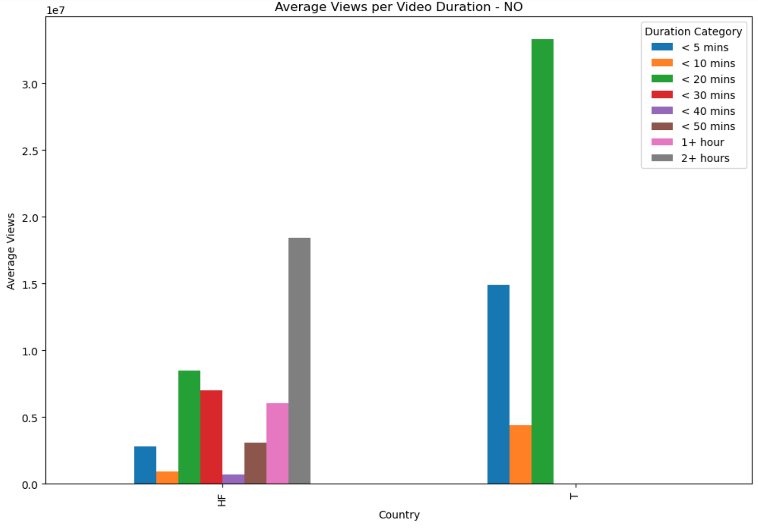
Average views per landing page and duration category - FR & NO

Slide 6
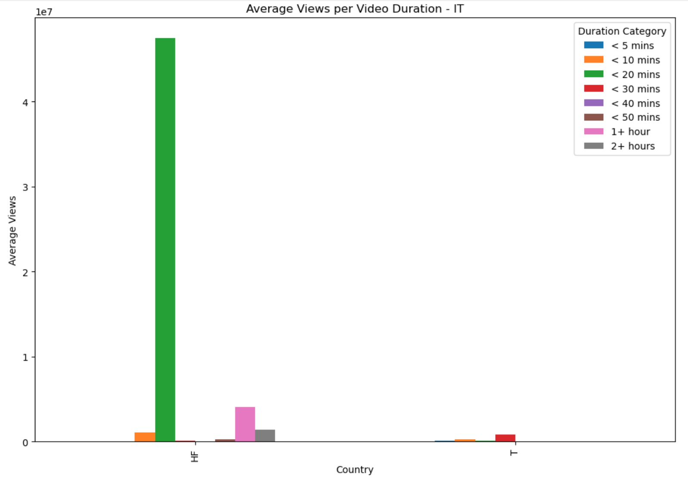
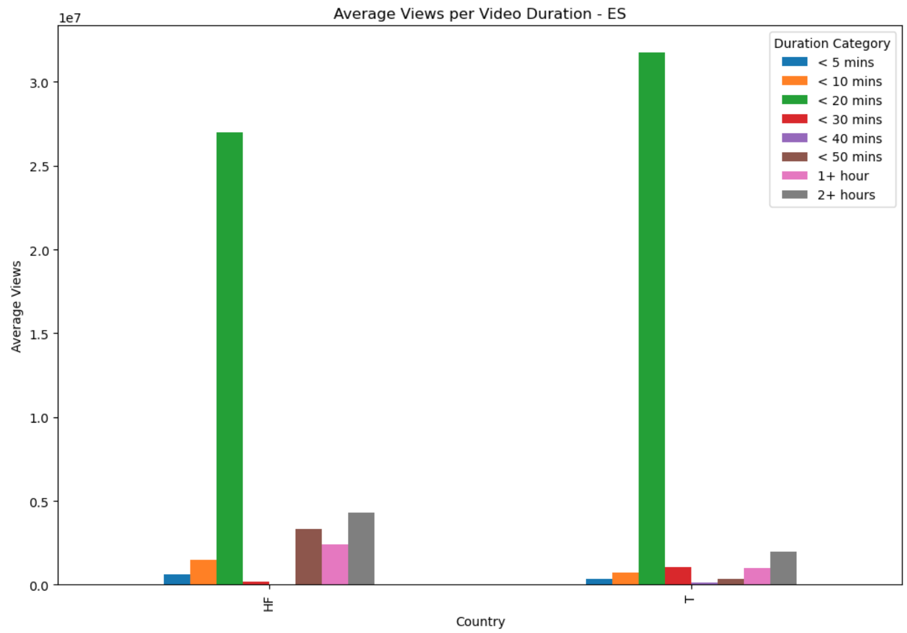
Average views per landing page and duration category - IT & ES

Slide 7
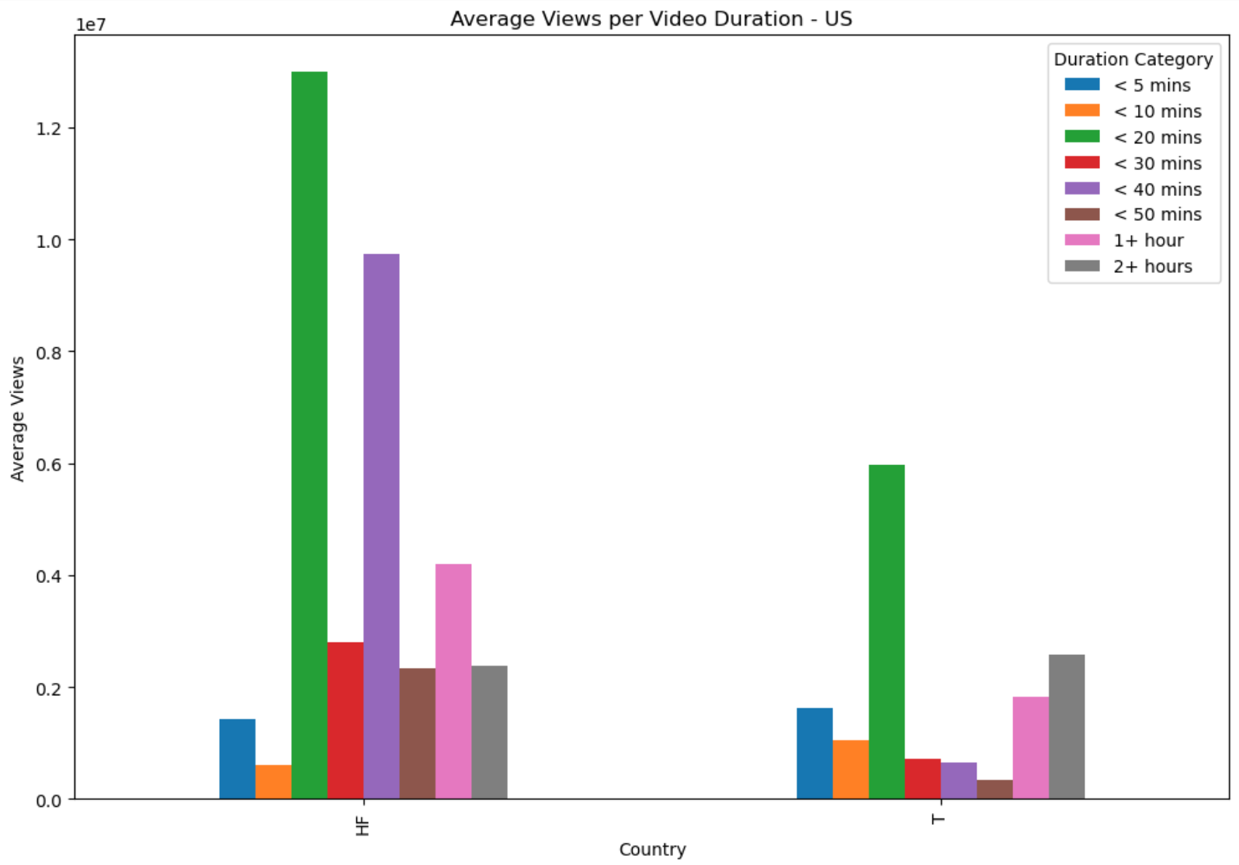
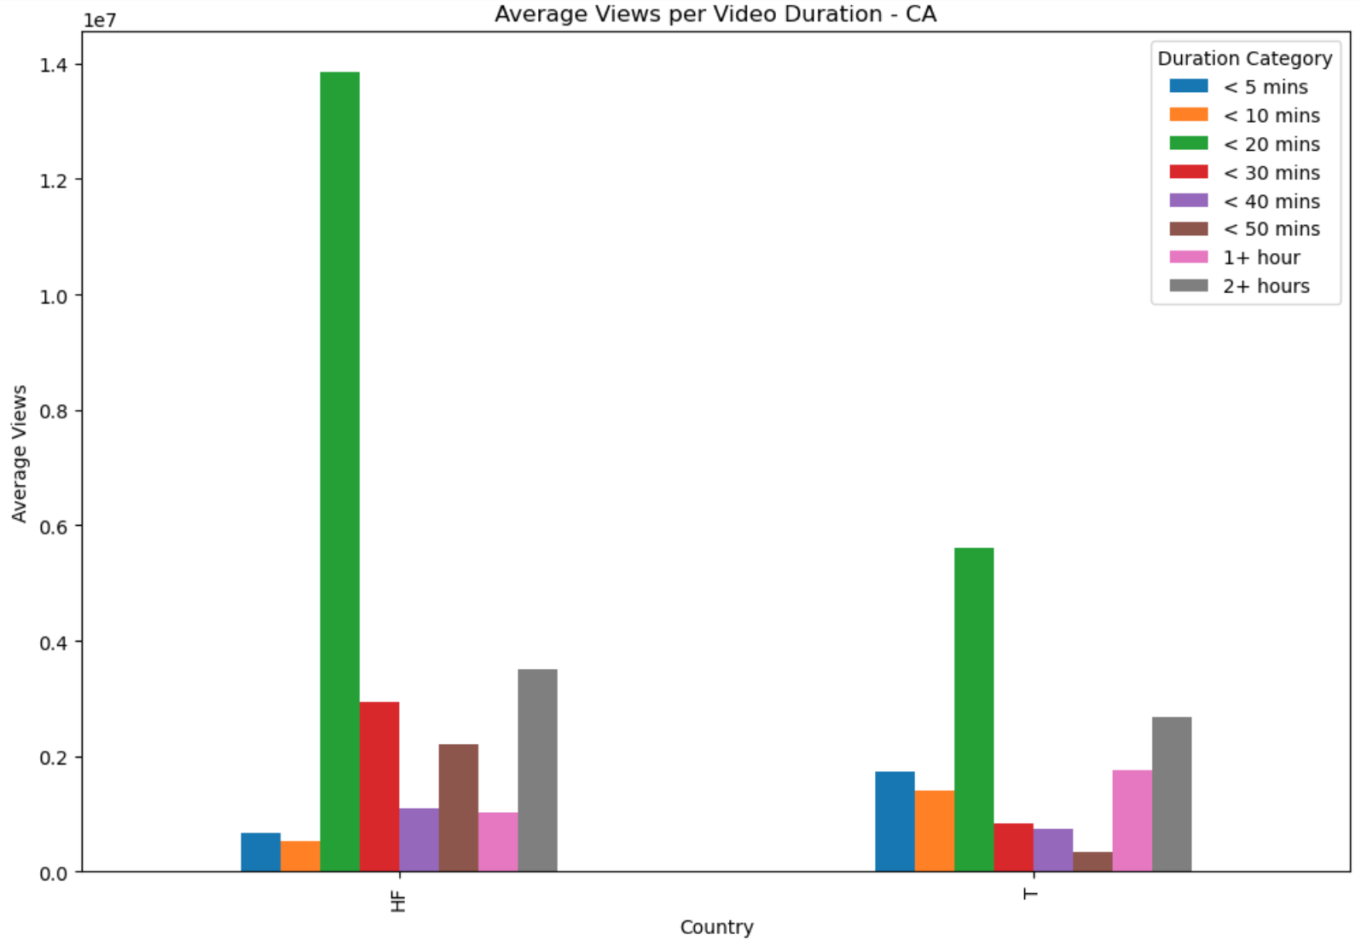
Average views per landing page and duration category - US & CA

Slide 8
Correlation between views and time per country

Slide 9
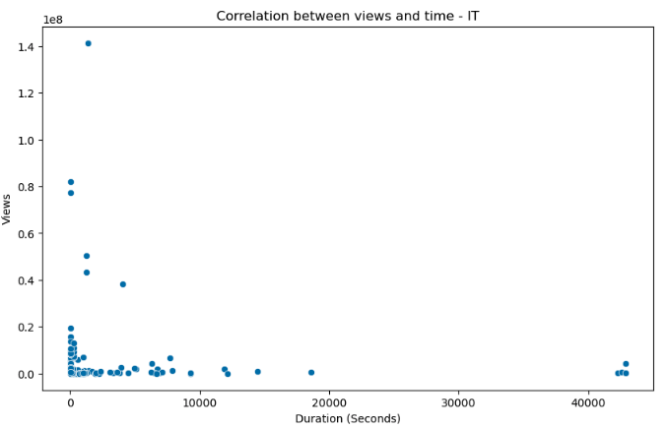
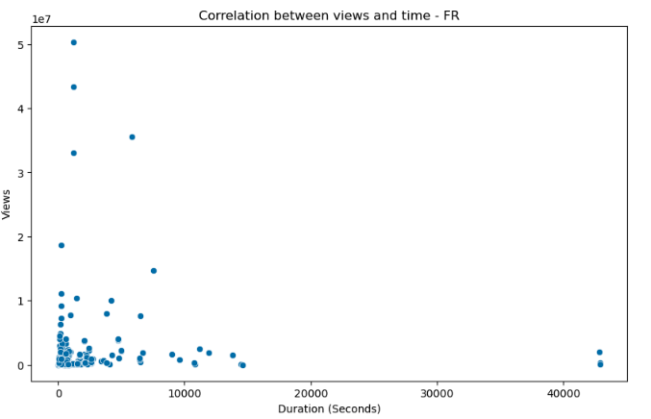
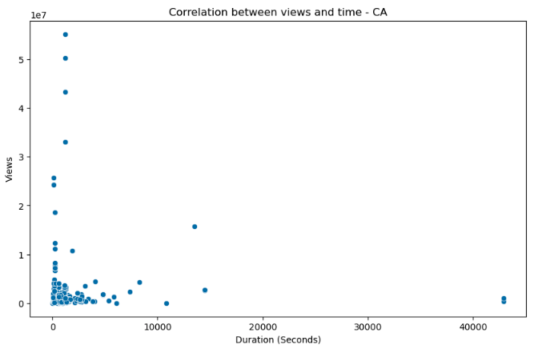
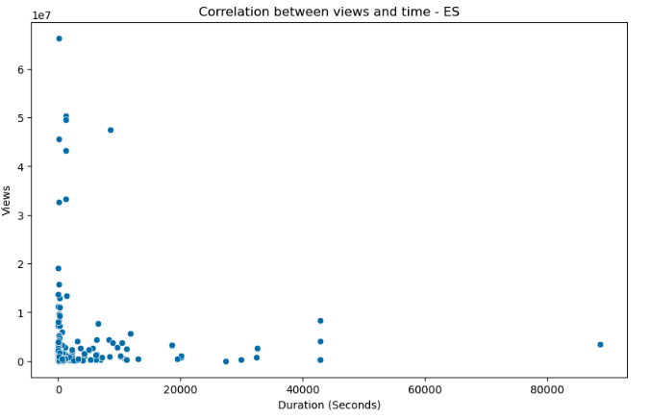
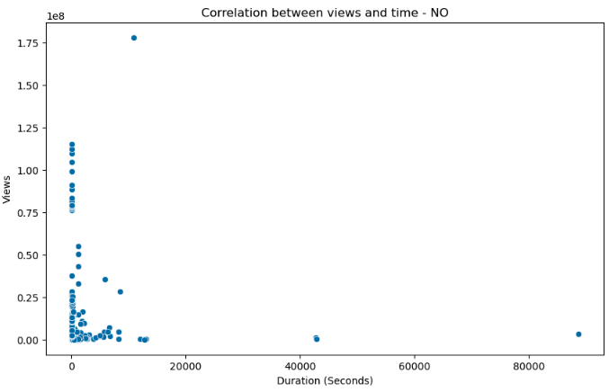
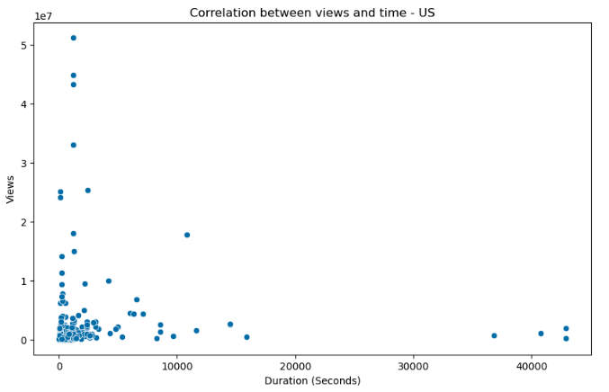
IT = – 0.056 FR = + 0.005 CA = – 0.027
ES = – 0.041 NO = – 0.08 US = – 0.035

Slide 10
Average views per categories of the top viewed videos per country

Slide 11
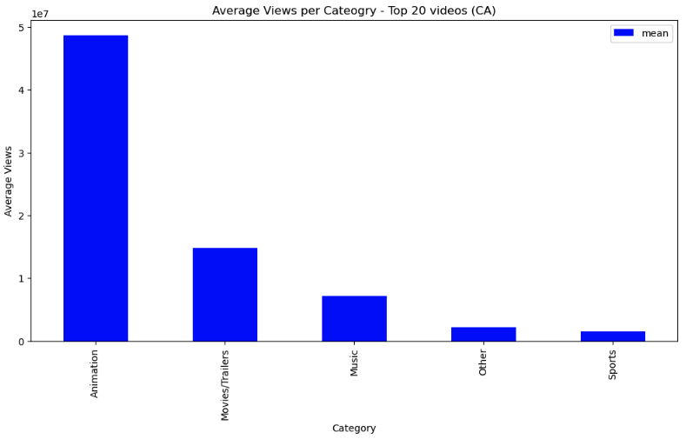
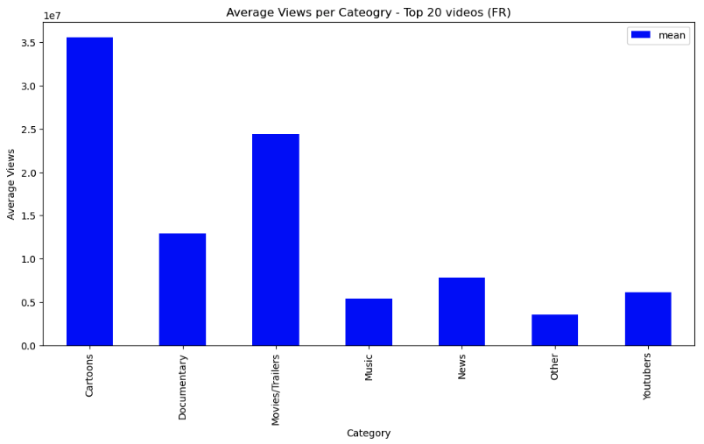
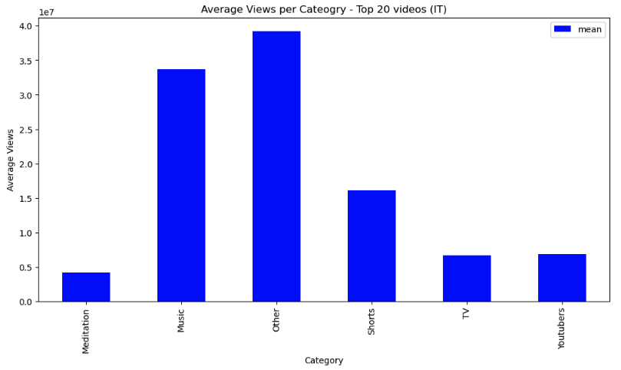
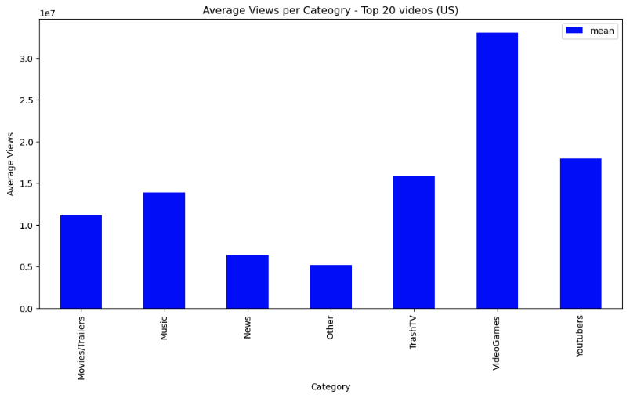
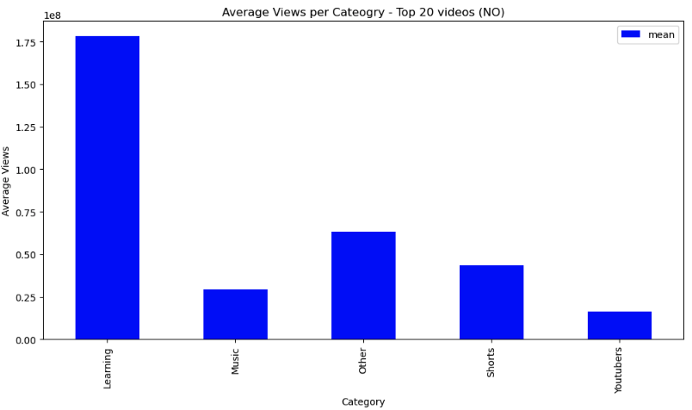
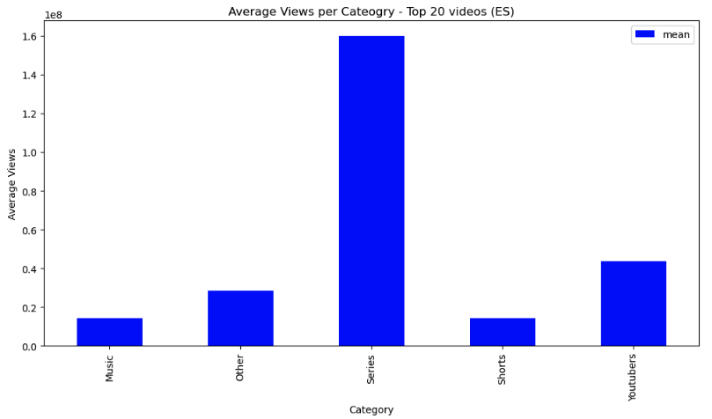

Slide 12
Differences within categories of top 20 videos with highest views
CA | Animation, Movies/Trailers, Music, Other, Sports
US | Video Games, Youtubers, TrashTV, Music, Movies/Trailers, News, Other
FR | Cartoons, Movies/Trailers, Documentaries, News, Youtubers, Music, Other
NO | Learning, Other, Sports, Music, Youtubers
IT | Other, Music, Shorts, Youtubers, TV, Meditation
ES | Series, Youtubers, Other, Sports, Music

Slide 13

Conclusion
Video length, category and geographical location significantly influences a video’s popularity.
Understanding these patterns over a longer period of time can help content creators tailor their content to specific audiences and optimize their approach to different markets
Further Steps:
→ Automate the requests of the API and gather information daily for a determined period of time.

Slide 14

Difficulties
API Selection
Cleaning:
Column hh:mm:ss
Turn column hh:mm:ss into seconds
Understanding the direction

